Slide 1
Competitive Algorithm Calculation Testing in a Unified System
(C.A.C.T.U.S.)
Requirements Specification
Presented By:
ExoNET Solutions
11/2/2011

Slide 2
Welcome
Dr. Darren Lim
Associate Professor of Computer Science
Siena College

Slide 3
Agenda
Introductions
Problem Overview
Project Status
User Case Narratives
UML Use Case Diagrams
Data Flow Diagrams
Functional and Non-Functional Requirements
Timeline
What is next for ExoNET?

Slide 4
ExoNET Solutions Team Members
David Purcell
Team Leader
Stephanie Del Belso
Documents Analyst
Thomas Delaney
Systems Administrator
Marco Samaritoni
Web Master
Paul Amodeo
Assistant Web Master

Slide 5
Agenda
Introductions
Problem Overview
Project Status
User Case Narratives
UML Use Case Diagrams
Data Flow Diagrams
Functional and Non-Functional Requirements
Timeline
What is next for ExoNET?

Slide 6
Problem Overview
Current contest system is loosely structured
Inconvenient for judges and contestants
Not easily maintained
Not fully automated

Slide 7
Agenda
Introductions
Problem Overview
Project Status
User Case Narratives
UML Use Case Diagrams
Data Flow Diagrams
Functional and Non-Functional Requirements
Timeline
What is next for ExoNET?

Slide 8
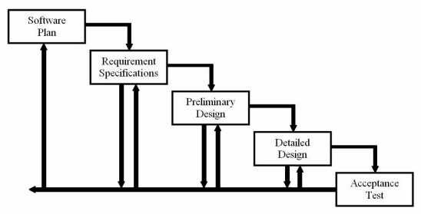
Project Status
Requirements Specification
Development
and
Testing

Slide 9
Agenda
Introductions
Problem Overview
Project Status
User Case Narratives
UML Use Case Diagrams
Data Flow Diagrams
Functional and Non-Functional Requirements
Timeline
What is next for ExoNET?

Slide 10
User Case Narratives
Describe the behavior of users within a system.
Aid in the discovery of requirements

Slide 11
User Case Narrative: System Administrator
Logs in/Logs out of C.A.C.T.U.S.
Has highest level privileges
Configures contest environment
Creates user accounts for a contest

Slide 12
User Case Narrative: Judge
Logs in/Logs out of C.A.C.T.U.S.
Is given teams to supervise
Communicates with teams
Reviews problem submissions

Slide 13
User Case Narrative: Contestant
Logs in/Logs out of C.A.C.T.U.S.
Familiarizes with C.A.C.T.U.S. interface
Submits problem submissions

Slide 14
User Case Narrative: Spectator
Logs in/Logs out of C.A.C.T.U.S.
Views scoreboard
Views contest problems

Slide 15
Agenda
Introductions
Problem Overview
Project Status
User Case Narratives
UML Use Case Diagrams
Data Flow Diagrams
Functional and Non-Functional Requirements
Timeline
What is next for ExoNET?

Slide 16
UML Use Case Diagrams
Visual representation of user behavior
Overview of User Case Narratives

Slide 17
UML Use Case Diagram Legend
Use Case
System Boundary
Participations
Actor (Human or Non-Human)

Slide 18
UML Use Case Diagram: C.A.C.T.U.S.

Slide 19
Agenda
Introductions
Problem Overview
Project Status
User Case Narratives
UML Use Case Diagrams
Data Flow Diagrams
Functional and Non-Functional Requirements
Timeline
What is next for ExoNET?

Slide 20
Data Flow Diagrams
Visual representation of data flow
System components are drawn at various levels of detail
Context Diagram – Highest level of abstraction and external users
Level 0 Diagram – Major processes and data
Level 1 Diagrams – More detailed view of a process

Slide 21
Data Flow Diagrams Legend
Data Source/Sink
Process
Data Flow
Data Store

Slide 22
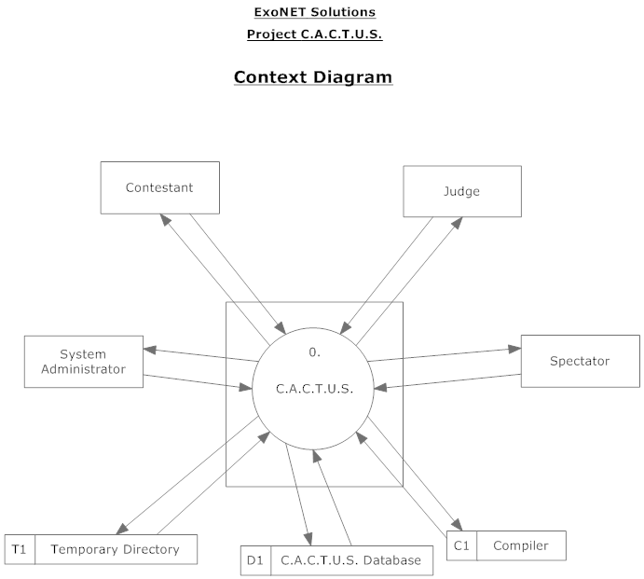
Data Flow Diagram: Context Diagram

Slide 23
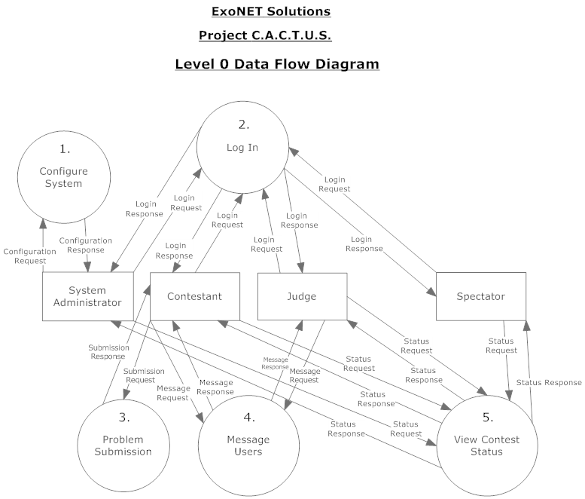
Data Flow Diagram: Level 0 Diagram

Slide 24
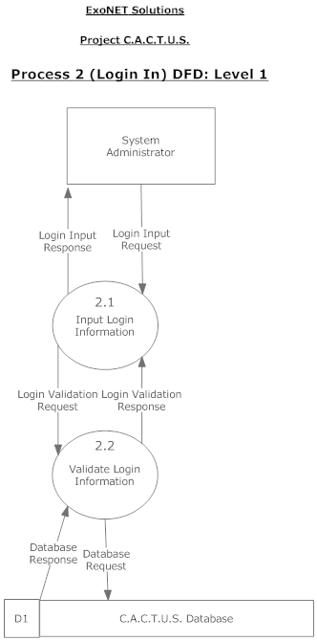
Data Flow Diagram: Process 2 (Log In), Level 1

Slide 25
Agenda
Introductions
Problem Overview
Project Status
User Case Narratives
UML Use Case Diagrams
Data Flow Diagrams
Functional and Non-Functional Requirements
Timeline
What is next for ExoNET?

Slide 26
Functional Requirements Inventory: C.A.C.T.U.S.
Responsive
Scalable
Robust
Usable in multiple Web Browsers
Run programming contests

Slide 27
Functional Requirements Inventory: System Administrator
Upload contest problems
Add/Drop Contestants
Create user accounts
Select contest languages

Slide 28
Functional Requirements Inventory: Judge
Process problem submissions from Contestants
Communicate with Contestants

Slide 29
Functional Requirements Inventory: Contestant
View contest problems
View scoreboard
Communicate with Judges
Submit problem submissions

Slide 30
Functional Requirements Inventory: Spectator
View contest problems
View scoreboard

Slide 31
Non-Functional Requirements
User friendly
Stable

Slide 32
Agenda
Introductions
Problem Overview
Project Status
User Case Narratives
UML Use Case Diagrams
Data Flow Diagrams
Functional and Non-Functional Requirements
Timeline
What is next for ExoNET?

Slide 33
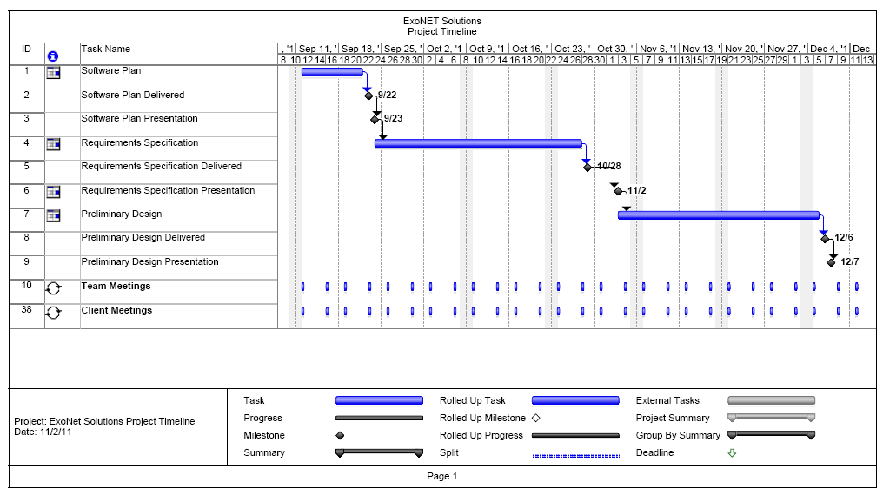
Timeline

Slide 34
Agenda
Introductions
Problem Overview
Project Status
User Case Narratives
UML Use Case Diagrams
Data Flow Diagrams
Functional and Non-Functional Requirements
Timeline
What is next for ExoNET?

Slide 35
What is next for ExoNET?
Preliminary Design – November 3rd – December 6th
Preliminary Design Delivered – December 6th, 2011
Preliminary Design Presentation – December 7th, 2011

Slide 36
Thank You.
Questions? Comments?

